Slide 1



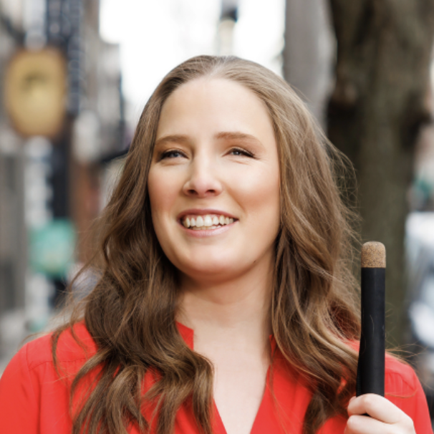

CHARTABILITY
Frank Elavsky, Comm Talk, 2022 @FrankElavsky
frank.computer/chartability
How accessible is my visualization? Evaluating visualization accessibility with Chartability.
hcii.cmu.edu
axle-lab.com
dig.cmu.edu
by Frank Elavsky, Cynthia Bennett, Dominik Moritz

Slide 2
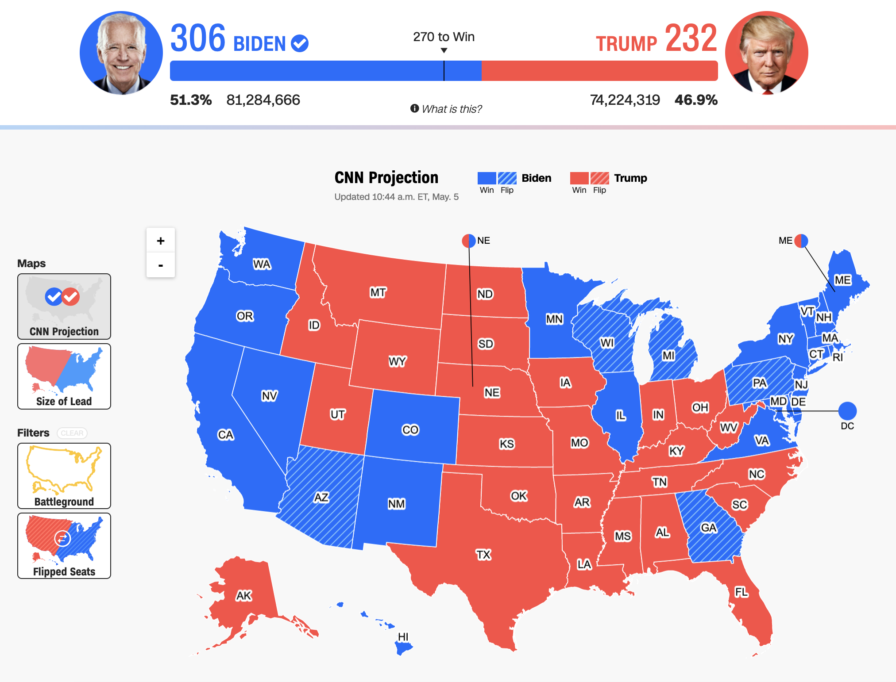
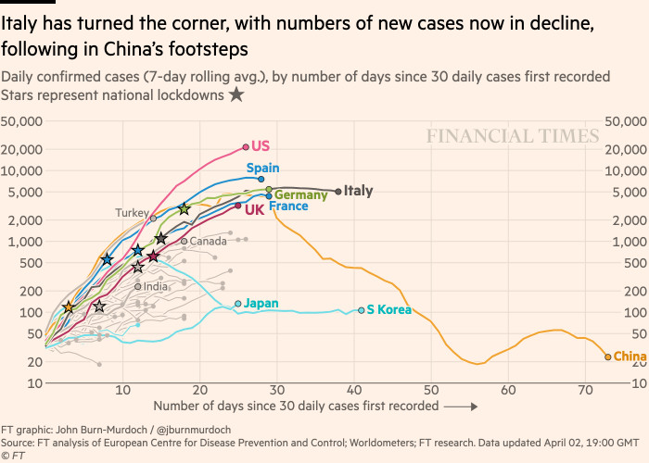
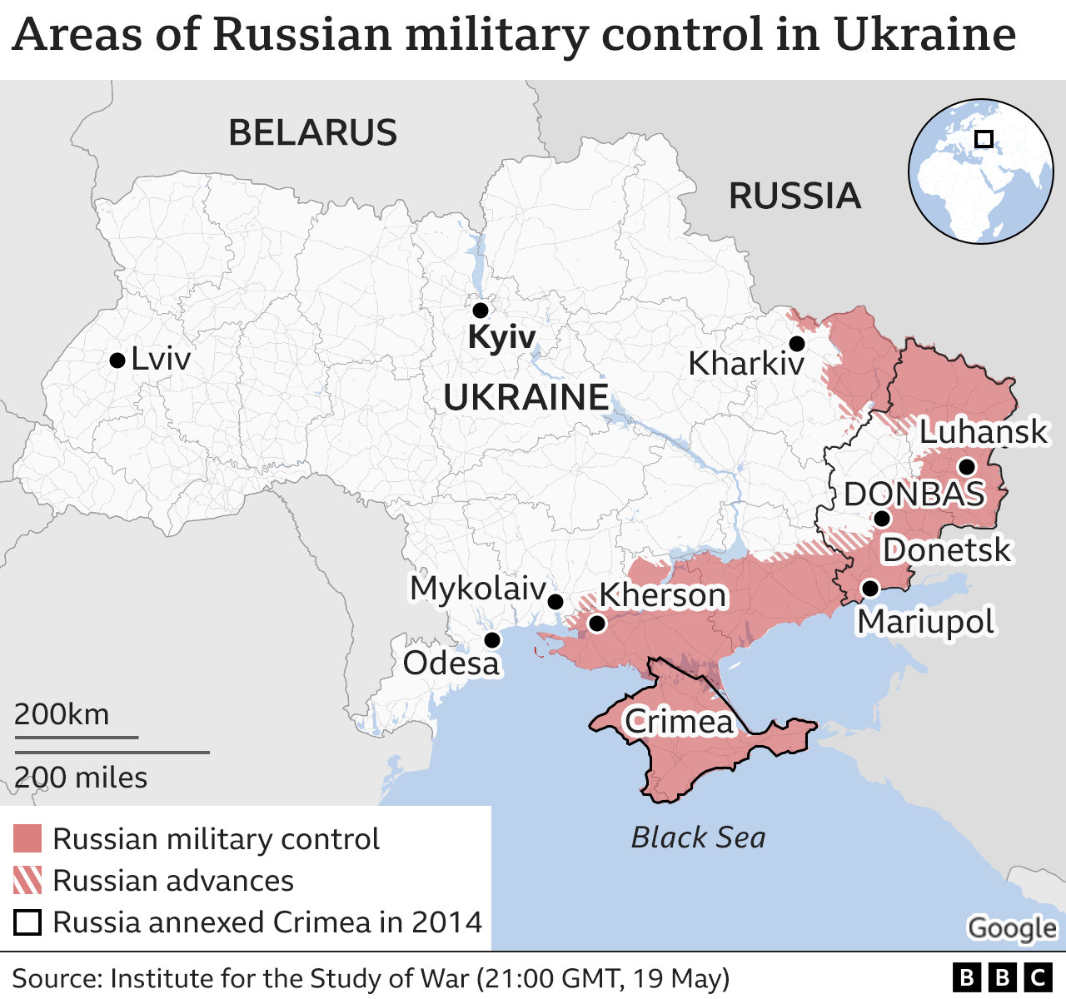
Visualizations inform the public and guide decision-making, policy, and business.
Politics
(CNN)
Health
(Financial Times)
Conflicts
(BBC)

Slide 3
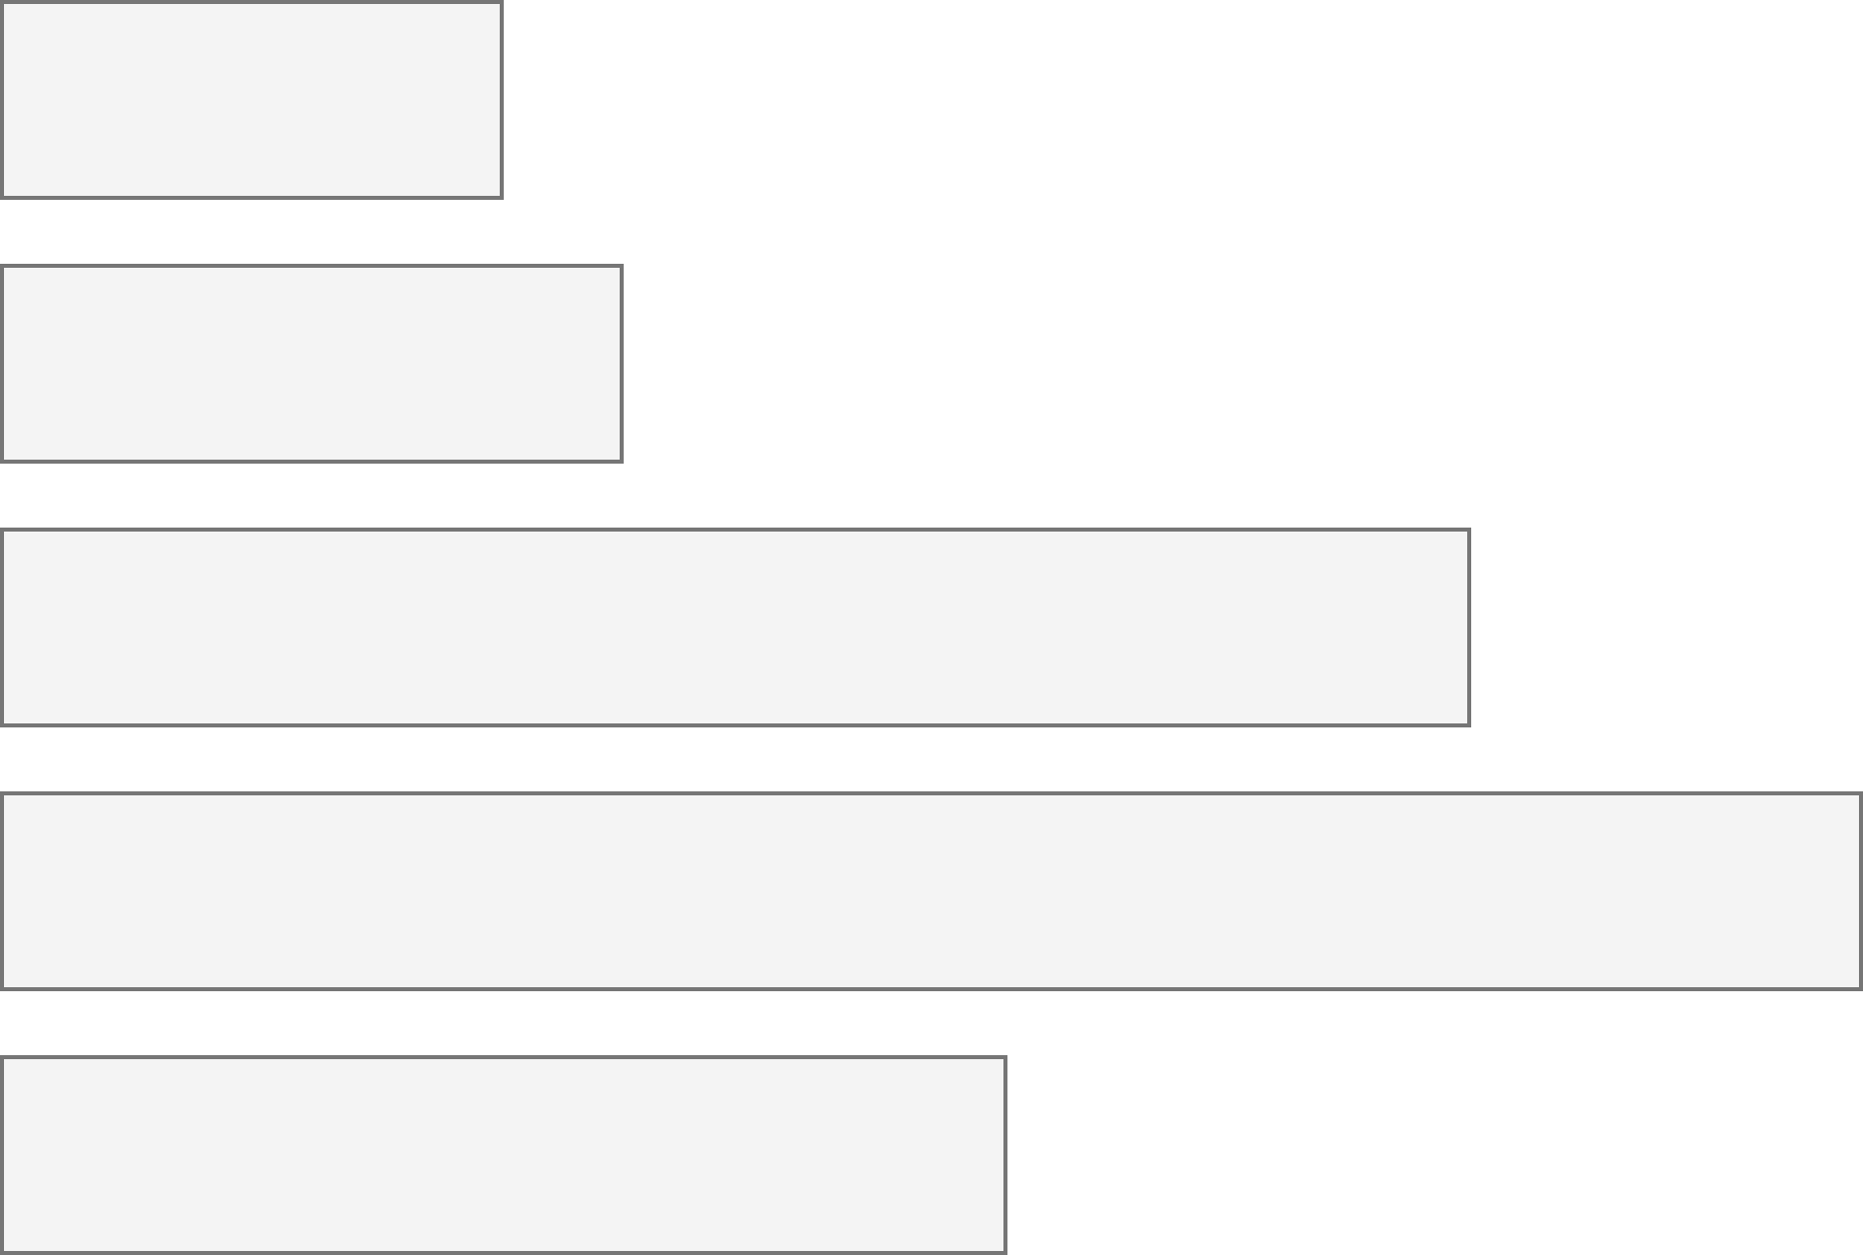
26% of people living in the United States self-report living with a disability that affects their daily life.
3.7%
Color Vision Deficiency
4.5%
Blindness, Low Vision
10.8%
Cognitive, Neurological
13.7%
Motor, Dexterity
7.4%
Vestibular, Motion
Source: Okoro et al. “Prevalence of Disabilities and Health Care Access by Disability Status and Type Among Adults”

Slide 4
Across >80,000 tests, most visualizations have about 320 accessibility errors each.
4

Slide 5
What does testing for accessibility look like?
5

Slide 6
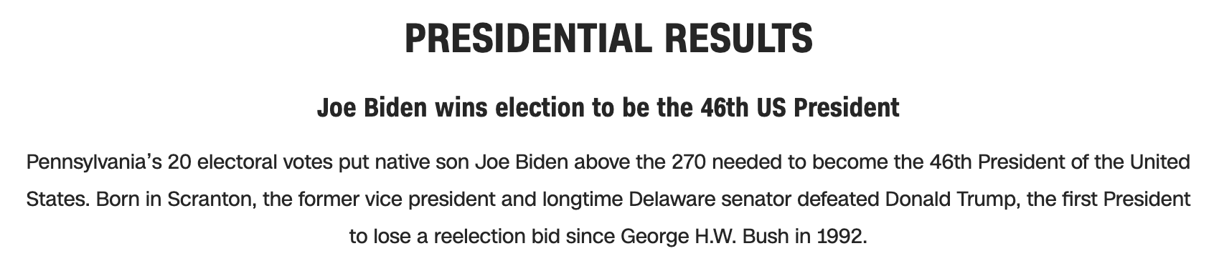
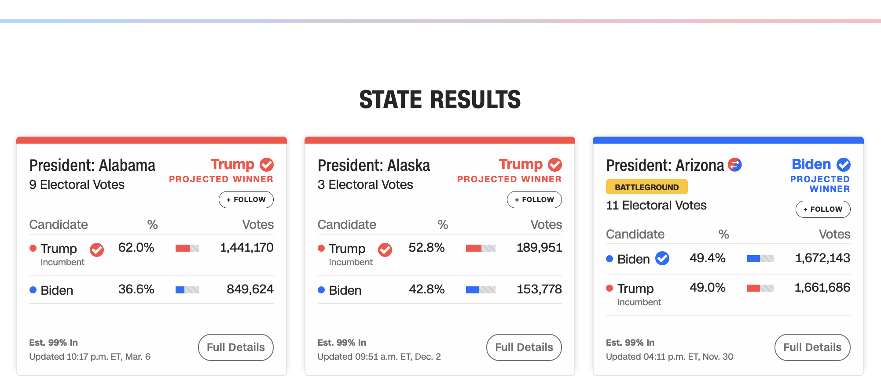

Let’s evaluate this one from CNN.

Slide 7
Perceivable Failures
6 – Low contrast
57 - Content is only visual
50 - Color alone is used
1 - Meaningful elements can be distinguished

Slide 8
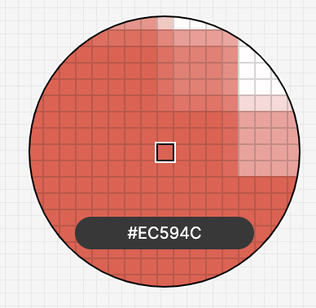
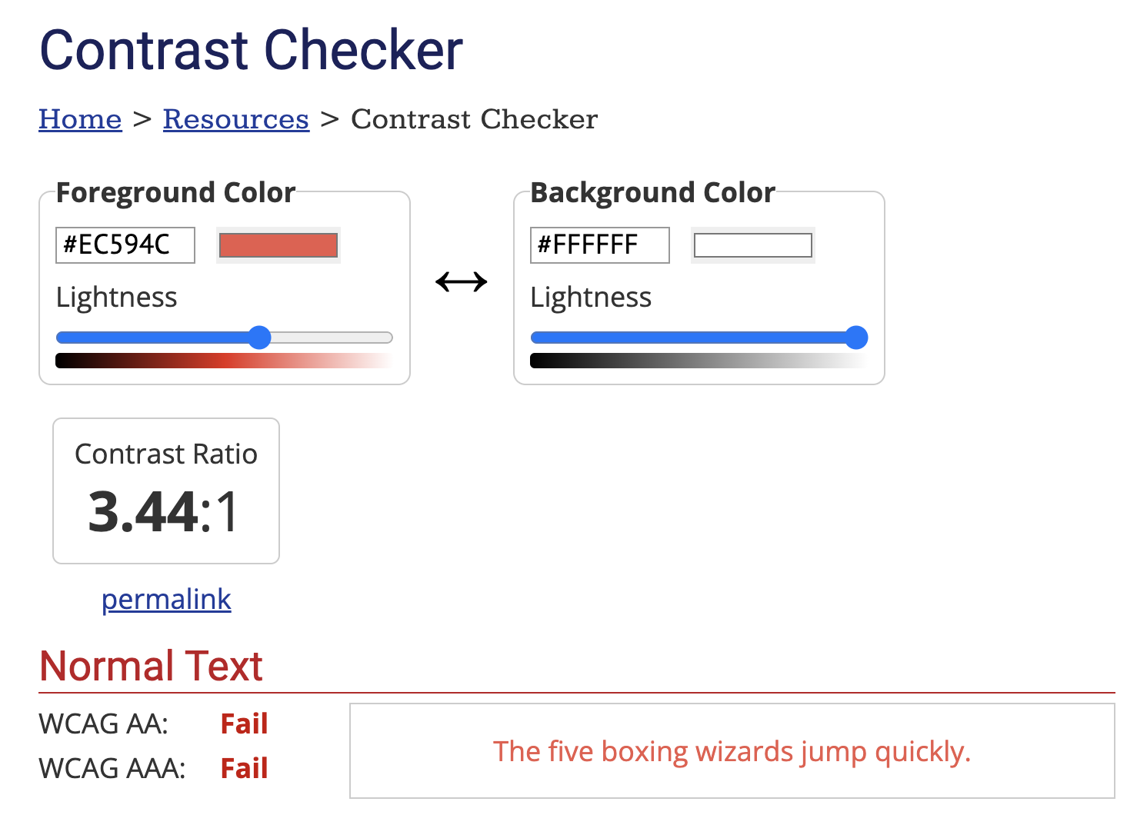


Slide 9
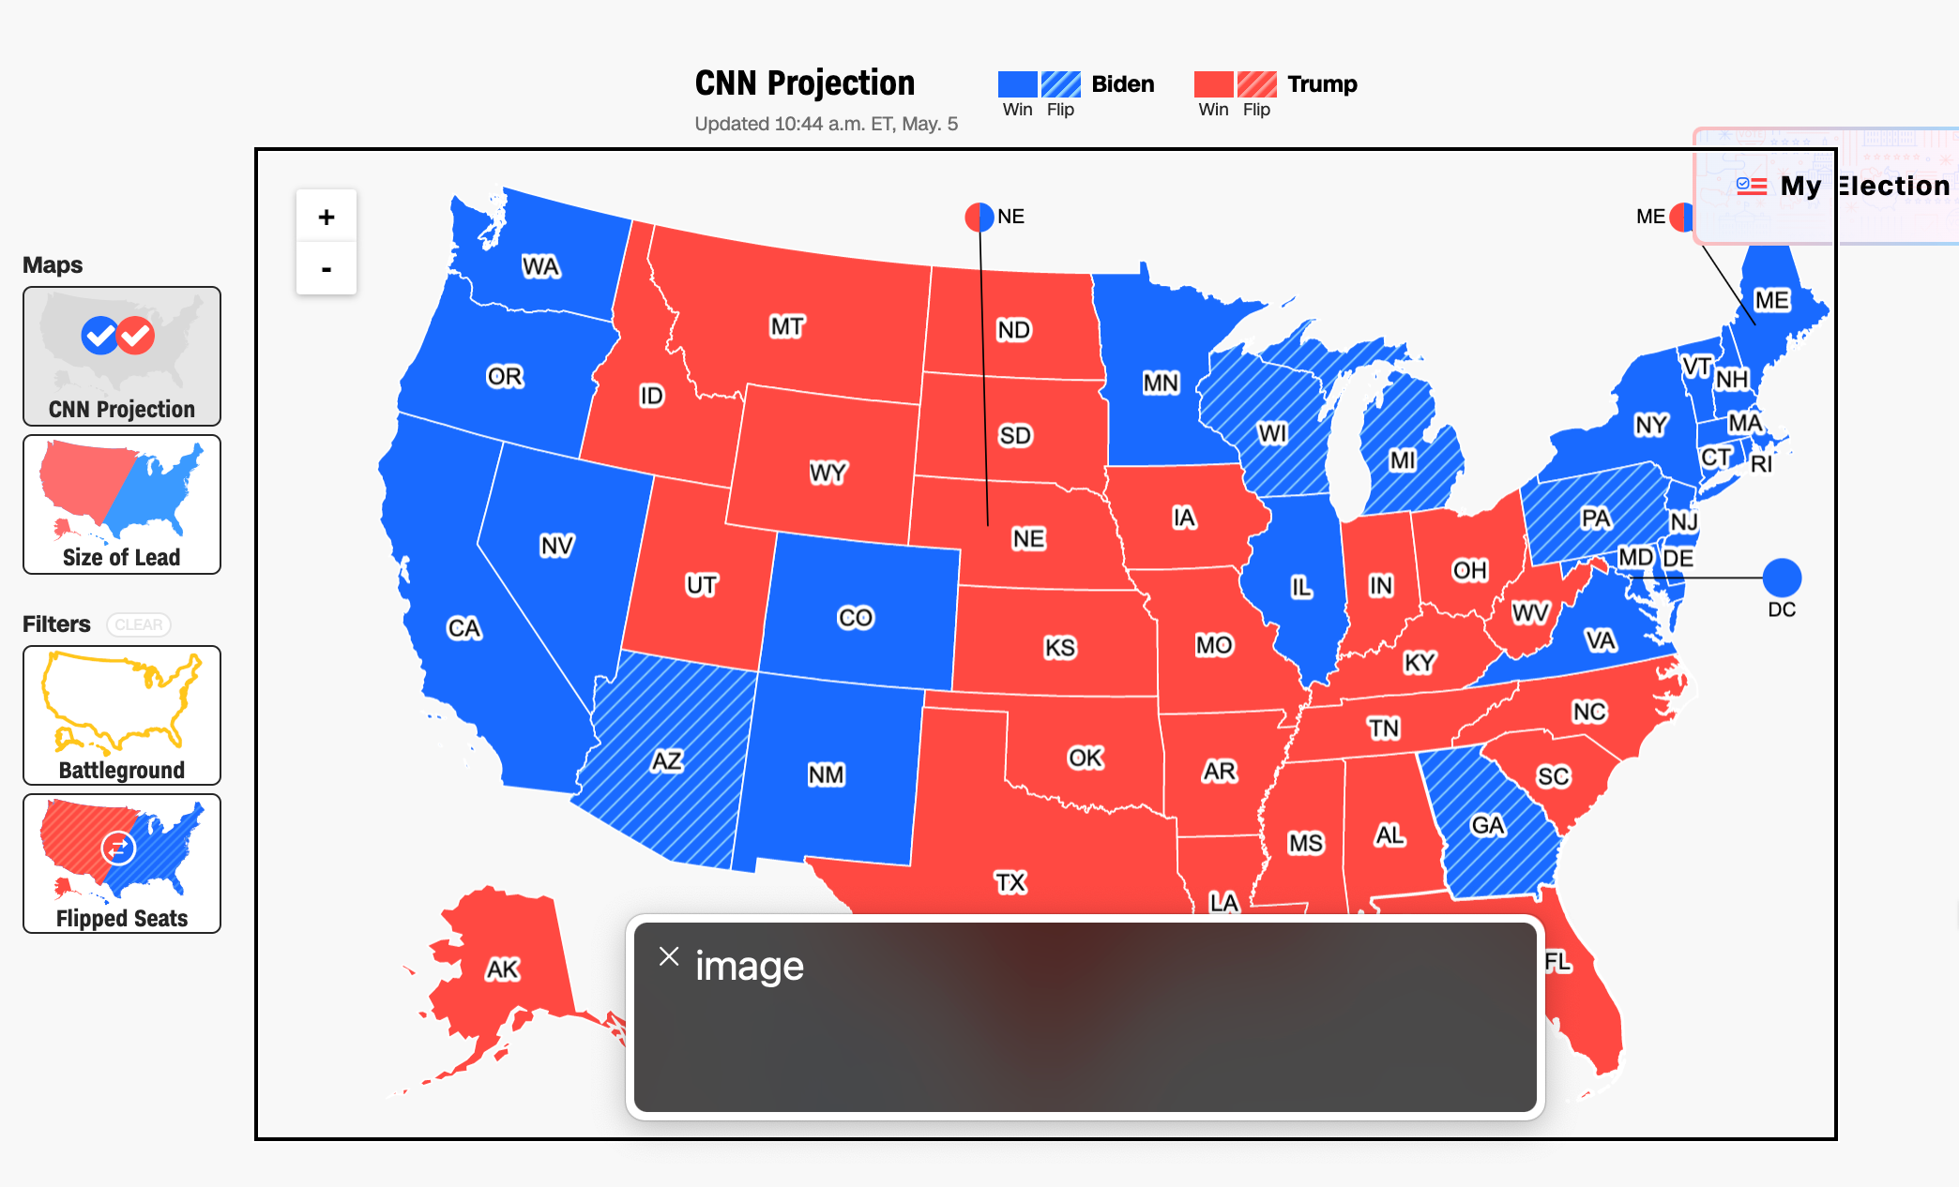
Perceivable Failures
6 – Low contrast
57 - Content is only visual
50 - Color alone is used
1 - Meaningful elements can be distinguished

Slide 10
Each state should announce to screen readers what state it is and who won it, not “image!”

Slide 11
Perceivable Failures
6 – Low contrast
57 - Content is only visual
53 - Color alone is used
1 - Meaningful elements can be distinguished

Slide 12
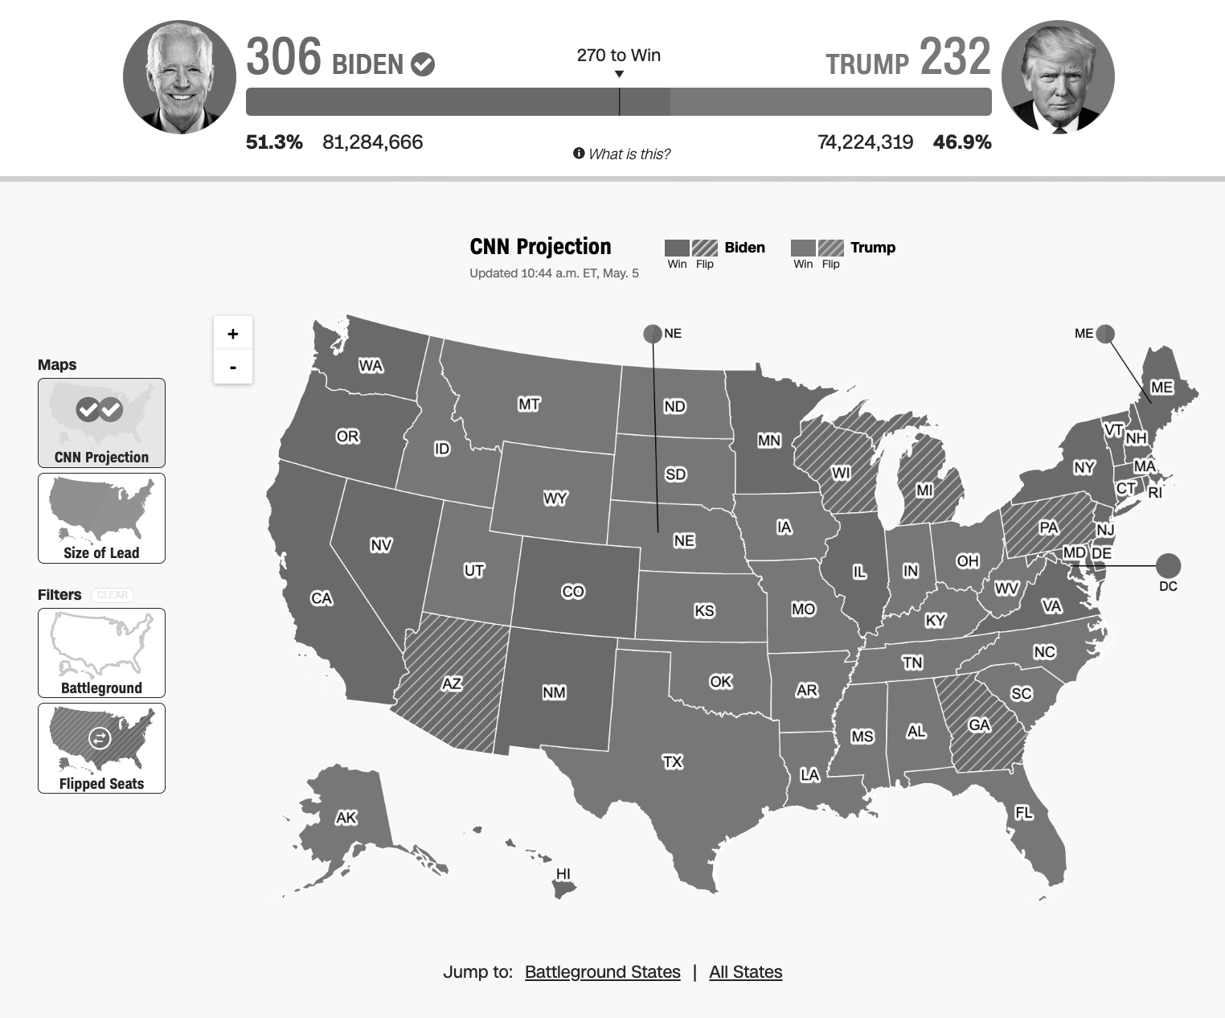
Some people use greyscale filters to help with perceptual sensitivities.
Notes:
Redundant encoding or having an interactive option to filter only on one encoding helps with many visual disabilities.

Slide 13
Perceivable Failures
6 – Low contrast
57 - Content is only visual
50 - Color alone is used
3 - Meaningful elements can be distinguished

Slide 14
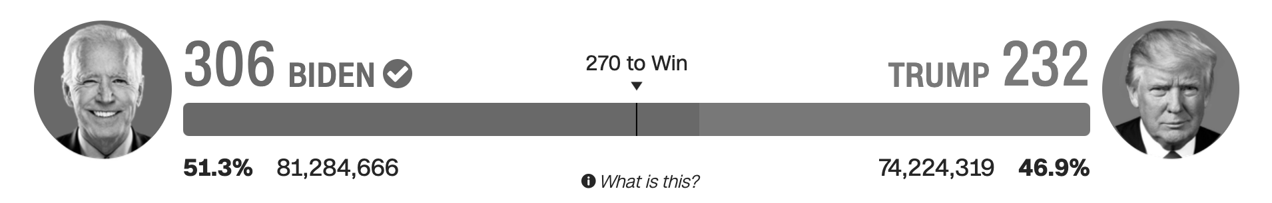
This tiny white separation significantly improves contrast for this critical area of the visualization.

Slide 15
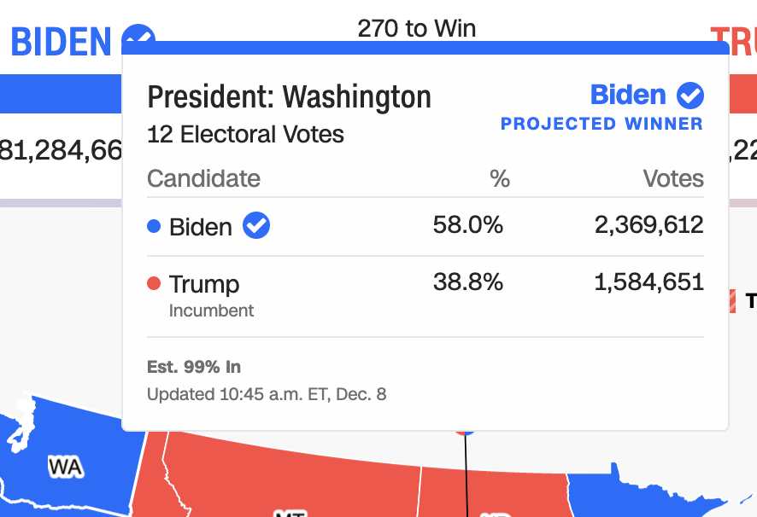
Operable Failures
54 - Interaction modality only has one input type
58 - No interaction cues or instructions
5 - Low contrast on interactive elements
4 - Keyboard focus indicator missing
4 - Complex actions have no alternative
18 - Target pointer interaction is too small

Slide 16


If a mouse can do something (like produce a tooltip), then there must be parity at least with a keyboard.
===

Slide 17
Operable Failures
54 - Interaction modality only has one input type
58 - No interaction cues or instructions
5 - Low contrast on interactive elements
4 - Keyboard focus indicator missing
4 - Complex actions have no alternative
18 - Target pointer interaction is too small

Slide 18
Operable Failures
54 - Interaction modality only has one input type
58 - No interaction cues or instructions
5 - Low contrast on interactive elements
4 - Keyboard focus indicator missing
4 - Complex actions have no alternative
18 - Target pointer interaction is too small

Slide 19
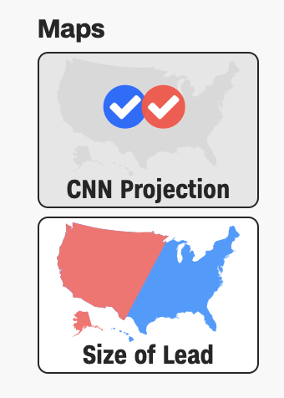
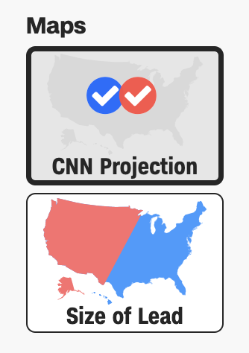
State and change of state must use sufficient contrast or not rely on color.
Fail
Pass

Slide 20
Operable Failures
54 - Interaction modality only has one input type
58 - No interaction cues or instructions
5 - Low contrast on interactive elements
4 - Keyboard focus indicator missing
4 - Complex actions have no alternative
18 - Target pointer interaction is too small

Slide 21
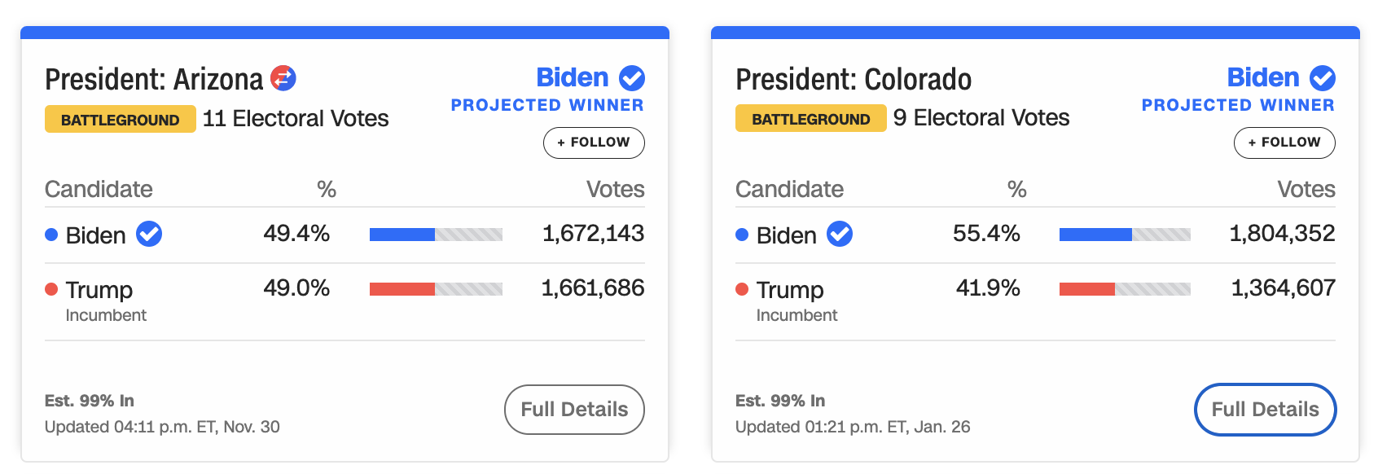
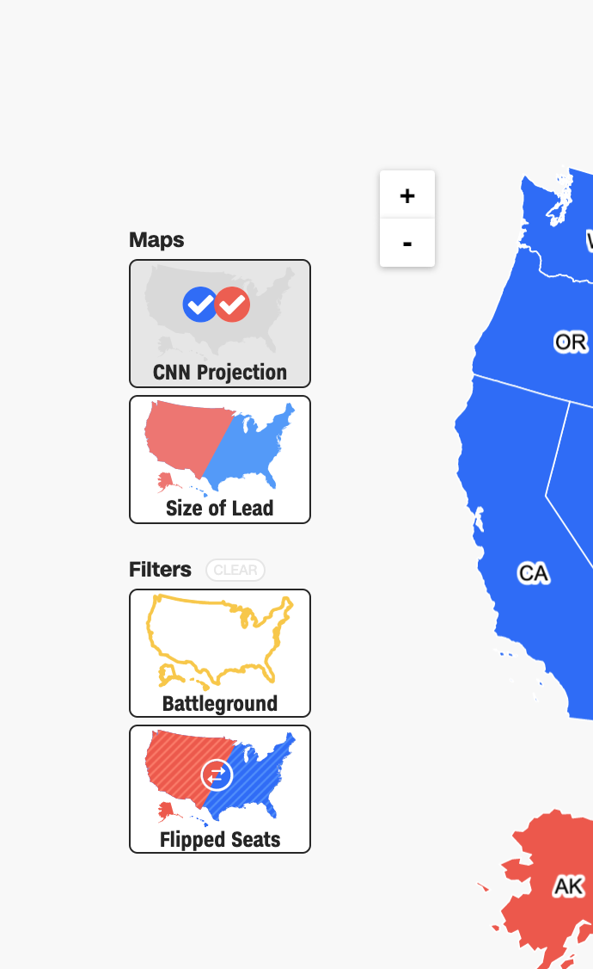
Keyboard focus indicator shows up here
But not here (2 mystery stops plus the map zoom buttons)

Slide 22
Operable Failures
54 - Interaction modality only has one input type
58 - No interaction cues or instructions
5 - Low contrast on interactive elements
4 - Keyboard focus indicator missing
4 - Complex actions have no alternative
18 - Target pointer interaction is too small

Slide 23
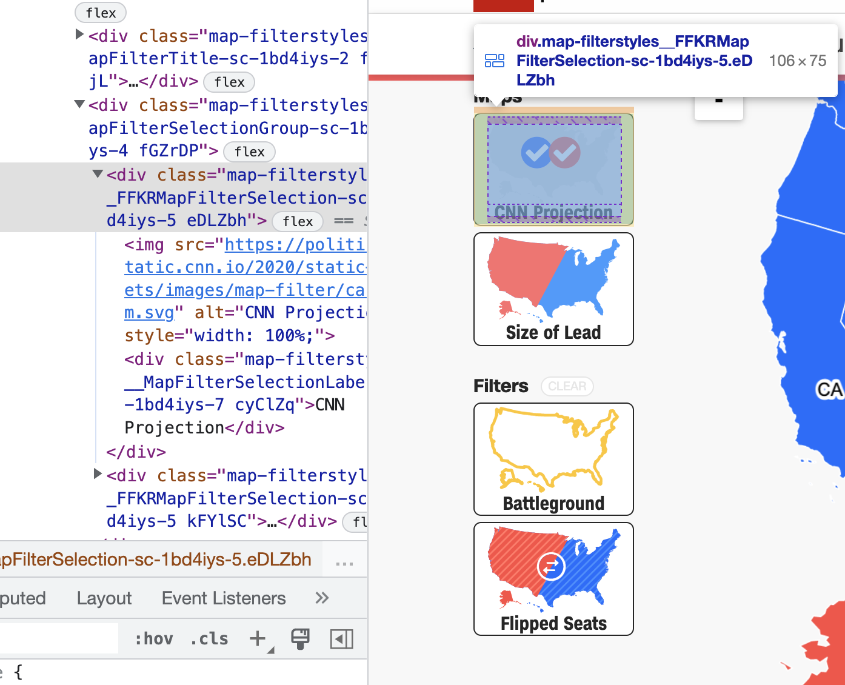
Overly complicated functionality and use of materials

Slide 24
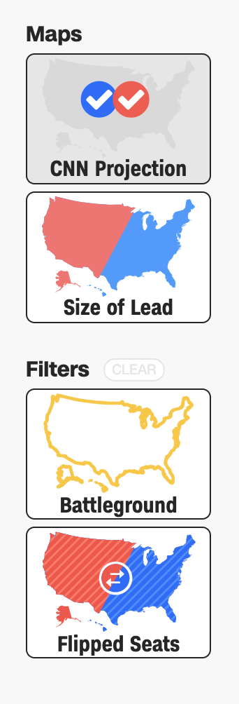
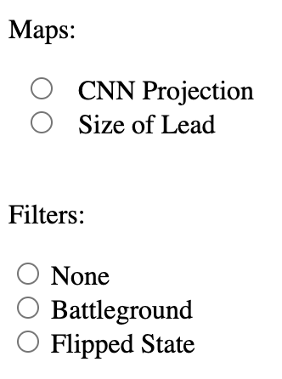
A simple functionality should be the default design or at least available

Slide 25
Operable Failures
54 - Interaction modality only has one input type
58 - No interaction cues or instructions
5 - Low contrast on interactive elements
4 - Keyboard focus indicator missing
4 - Complex actions have no alternative
18 - Target pointer interaction is too small

Slide 26
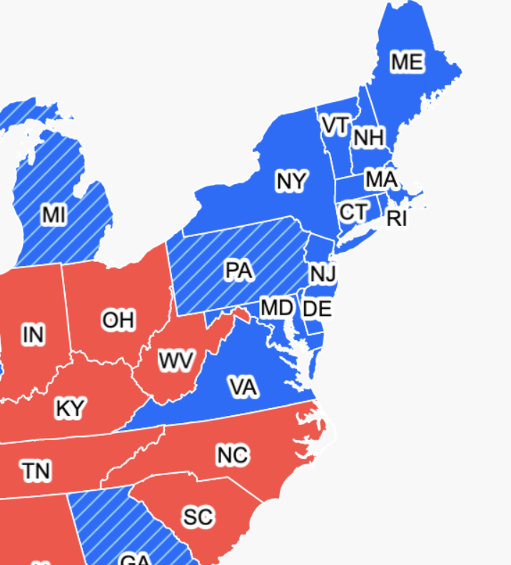

Expecting users to hover on something tiny is an accessibility design failure

Slide 27
Continue this for: Understandable,
Robust,
Compromising,
Assistive,
and Flexible

Slide 28
978 access failures found in ~60 minutes.
Robust:
275 - Does not conform to standards
82 - Semantically invalid
12 - Fragile technology support
Compromising:
54 - Information can only be reached through single process
61 - Information cannot be navigated according to narrative or structure
Assistive:
101 - Navigation and interaction is tedious
Flexible:
2 - User style change not respected
121 - User text adjustments are not respected
1 - Scrolling experiences cannot be adjusted or opted out of
Contrast and textures cannot be adjusted
Perceivable:
6 – Low contrast
57 - Content is only visual
50 - Color alone is used
3 - Meaningful elements can be distinguished
Operable:
54 - Interaction modality only has one input type
58 - No interaction cues or instructions
5 - Low contrast on interactive elements
4 - Keyboard focus indicator missing
4 - Complex actions have no alternative
18 - Target pointer interaction is too small
Understandable:
4 - Interactive context is not clear
6 - Metrics or variables are undefined
28
Notes:
Make sure to signal that this was from Chartability!!

Slide 29
Doing this work is hard.
29

Slide 30
Conjecture 1: we can’t build a more accessible world if we don’t know how to recognize accessibility barriers.
30

Slide 31
Conjecture 2: most practitioners don’t know how to recognize accessibility barriers because learning how is difficult and intimidating.
31

Slide 32
My hypothesis: if we can collect and synthesize existing knowledge for practitioners into a usable artifact, we can improve how they do this work.
32

Slide 33
Creators
33

Slide 34
Creators
Tools
34

Slide 35
Creators
Tools
Things
35

Slide 36
Creators
Tools
Things
Future Things
36

Slide 37
But how much of this is inaccessible?
Creators
Tools
Things
Future Things
37

Slide 38
97-99.9%
Creators
Tools
Things
Future Things
Source: World Wide Web Consortium. “The WebAIM Million.”
38

Slide 39
Dreaming of ideals
Creators
Tools
Things
Future Things
39
Notes:
Common, the way most people do this work

Slide 40
The knowledgeable “specialist” intervenes
Creators
Tools
Things
Future Things
40
Notes:
Common, the way most people do this work

Slide 41
We change our systems, laws, and environments
Creators
Tools
Things
Future Things
41

Slide 42
We give creators better tools
Creators
Tools
Things
Future Things
42

Slide 43
Chartability seeks to add knowledge as a tool to motivate practitioner behavior.
Creators
Knowledge
Created Things (now)
Future Things
43

Slide 44
What is Chartability?
44

Slide 45
A workbook!
45

Slide 46
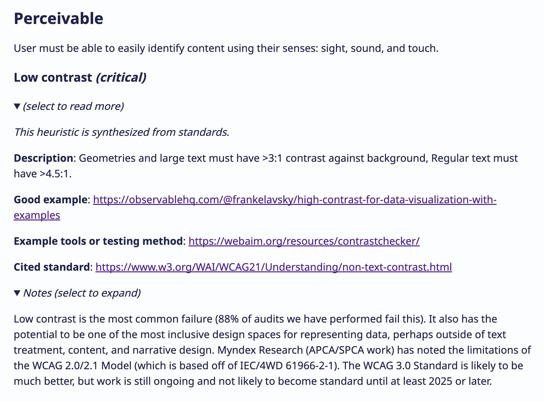
46

Slide 47
Heuristics
47

Slide 48
Examples
48

Slide 49
Techniques and automated and manual tools
49

Slide 50
More information
50

Slide 51
Why dream of knowledge and not an automated tool that solves everything?
51

Slide 52
Techniques and automated and manual tools
52

Slide 54
How did we make Chartability?
54

Slide 55
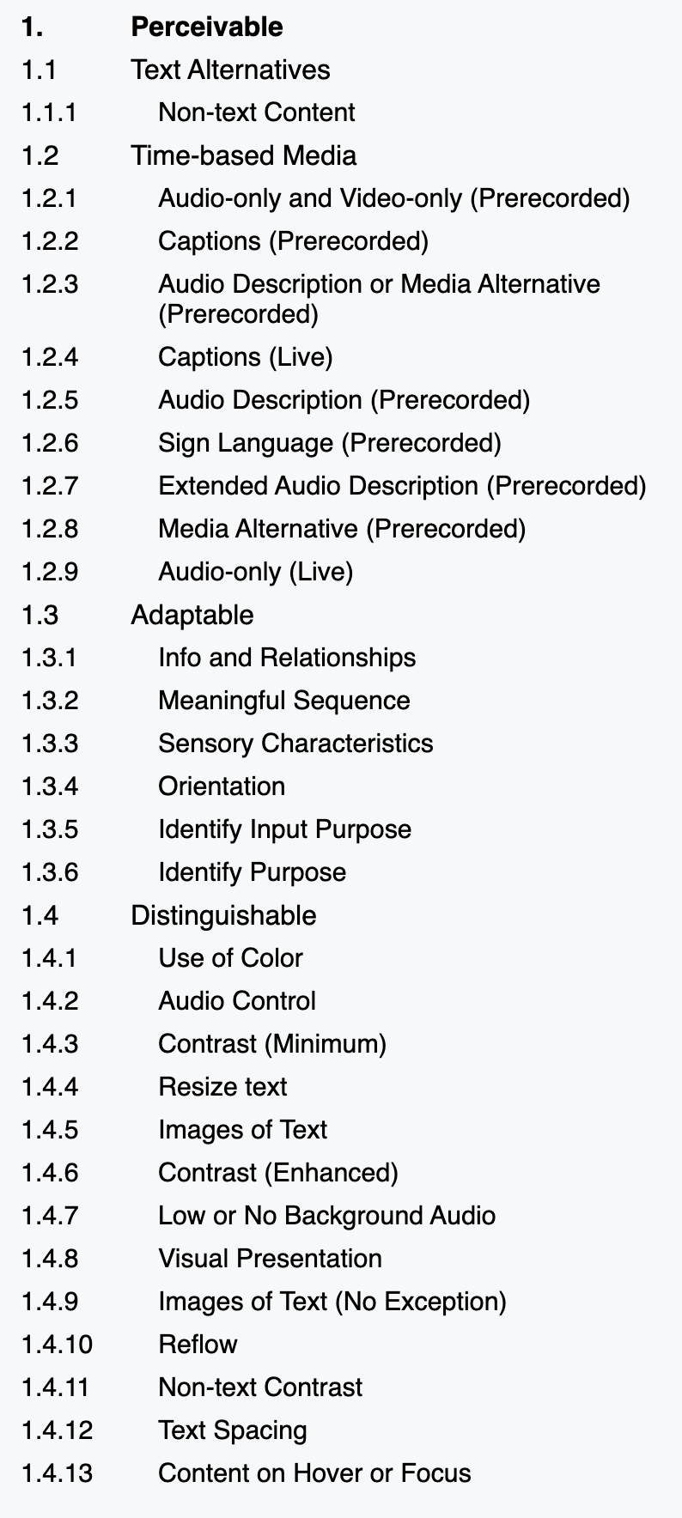
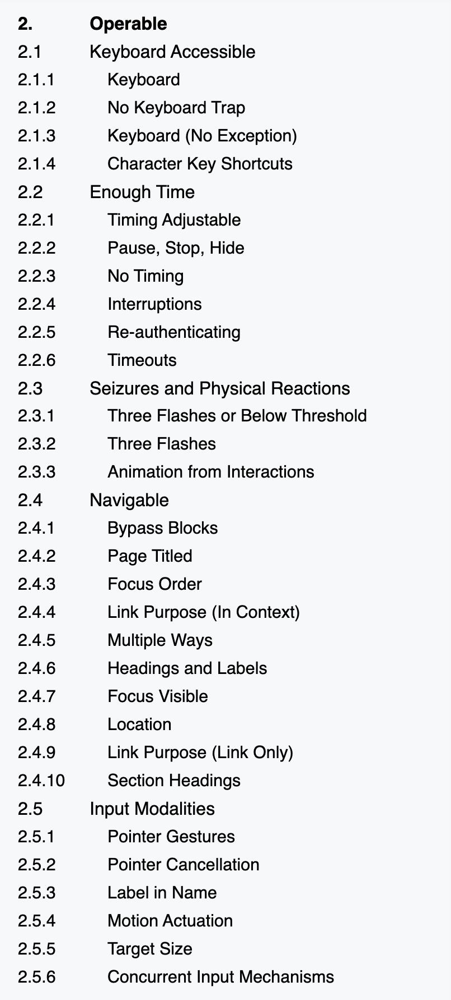
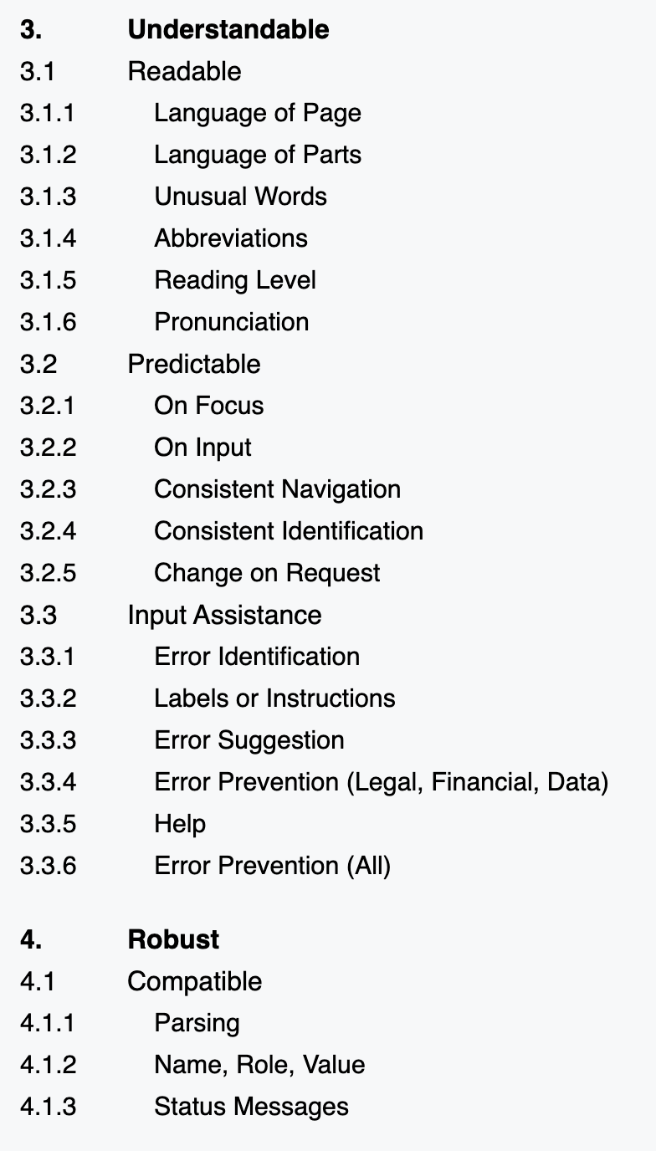
Web Content Accessibility Guidelines
55

Slide 56
Input data: a goldilocks problem
We lacked input data that was just right.
Web Standards
Academic Research
Practitioner Artifacts
Too broad for visualization.
Heavily focused on vision.
Technically specific.

Slide 57
Thematic analysis of standards, research, and practitioner artifacts produced 45 heuristics.
Coded Data
Web Standards
Academic Papers
45 Heuristics
Practitioner Artifacts
(all data tagged with 29 Codes)

Slide 58
26 of our heuristics neatly fit back in to WCAG’s 4 Principles
Perceivable (7)
Operable (7)
26 Simple Heuristics
Understandable (9)
Robust (3)

Slide 59
But 19 were complex combinations of the first 4 and demanded new themes.
Perceivable (7)
Operable (7)
26 Simple Heuristics
Understandable (9)
Robust (3)
Compromising (7)
19 Complex Heuristics
Assistive (5)
Flexible (7)

Slide 60
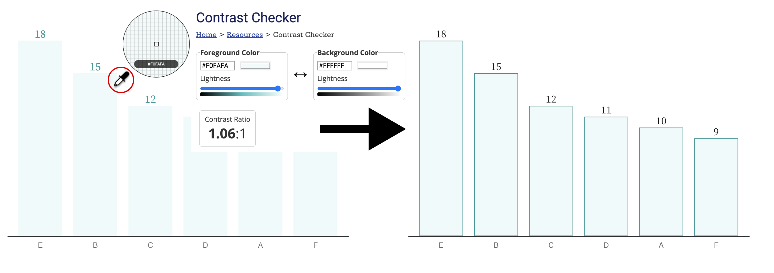
Perceivable:
Heuristics that focus on different ways of perceiving.
Notes:
Make more of a note!!!

Slide 61
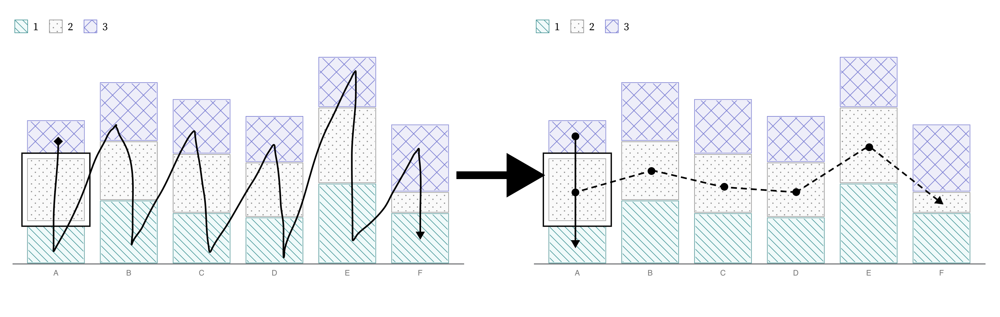
Operable:
Heuristics that focus on different ways of interacting.

Slide 62
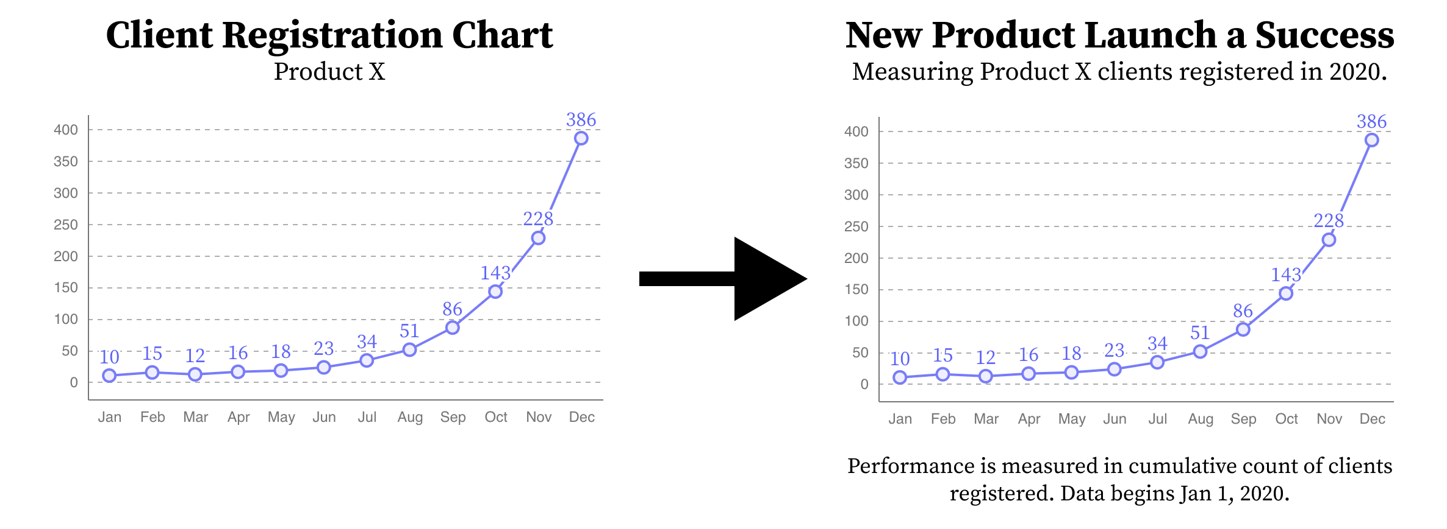
Understandable:
Heuristics that focus on a minimum level of comprehension.

Slide 63
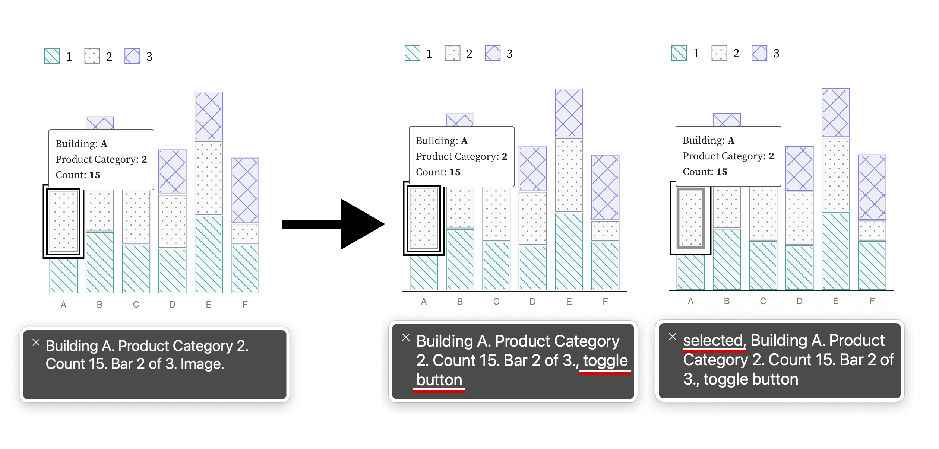
Robust:
Heuristics that focus on standards, semantics, and technological interoperability.

Slide 64
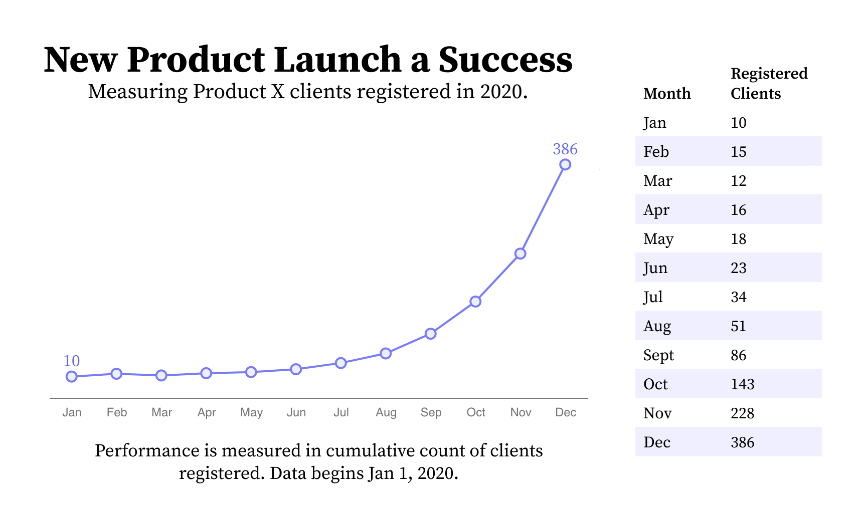
Compromising:
Heuristics that mix understandable and robust, evaluating the different ways people use and understand information during interaction.

Slide 65
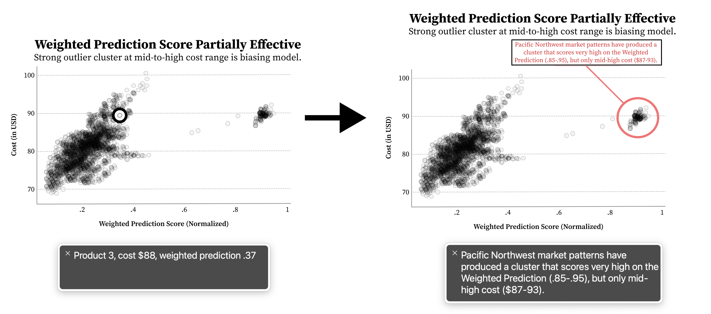
Assistive:
Heuristics that mix understandable and perceivable, focusing on the labor required for access.

Slide 66
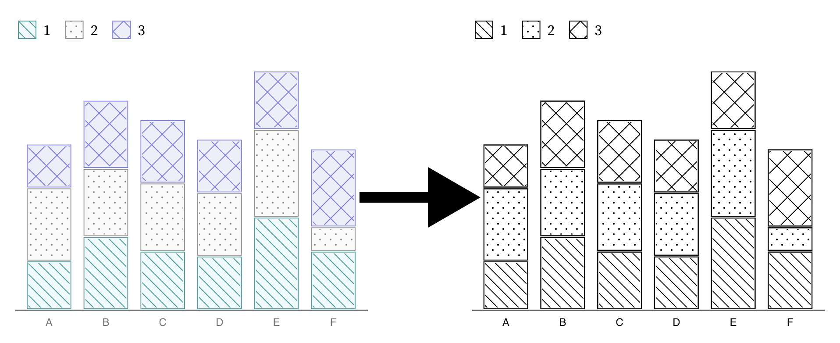
Flexible:
Heuristics that mix perceivable and robust, emphasizing the importance of adjustable and adaptive presentations.

Slide 67
How did we evaluate Chartability?
67

Slide 68
Most research evaluating heuristics measures consistency across evaluations or the effectiveness of the outcomes.
68

Slide 69
A: 54 errors vs B: 61…
69

Slide 70
Can we find cases where practitioners found this work intimidating and are now more confident and willing?
70

Slide 71
“An organized set of heuristics and examples gave me the confidence I needed!”
71

Slide 72
5 stages of evaluation
4 Beta Tests
Early Advice
2 Demo Sessions
Professional Workshop
Practitioner Test + Interview
72

Slide 73
First 4 evaluations helped us discover critical heuristics and improve
Deep Feedback Sessions
Professional Workshop
Beta Testing
Early Advice
4 preliminary audits
4 experts and 6 PWD
14 experts, 5 with disabilities
50 participants
10 Critical Heuristics

Slide 74
#5: Testing Chartability in the wild
We chose to evaluate real projects being worked on by real teams. All participants are experts in data visualization.

Slide 75
3 accessibility novices. Each with 1 project.

Slide 76
The practitioner test
Pre-questions (likert)
Let them use Chartability while we observe (2 – 8hr sessions)
We ask post-questions
After the session, we separately audit their work for comparison
76

Slide 77
3 accessibility experts. 2 with a shared project.

Slide 78
Novices: 3 / 3 felt more confident auditing visualizations for accessibility after Chartability.

Slide 79
Expansive:
“Chartability helps me consider so much more than colorblindness”

Slide 80
Clarifying:
“I was overwhelmed by accessibility at first. But after trying Chartability, now I feel like I have a process.”

Slide 81
Experts: 3 / 3 intend to keep using Chartability in their own professional work.

Slide 82
Grounding:
“Chartability did a very good job of highlighting concerns that are often ignored or forgotten when auditing and designing/developing”

Slide 83
Goes beyond:
“Chartability goes beyond compliance. It is clearly focusing on a good experience.”

Slide 84
What other results are worth noting from Chartability’s use?

Slide 85





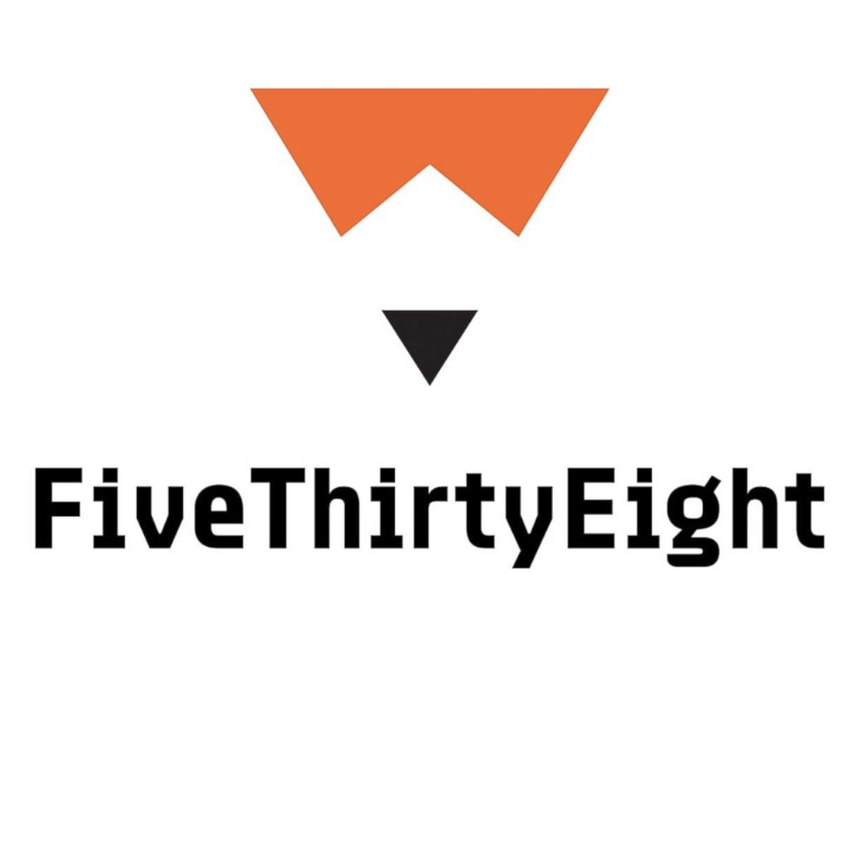




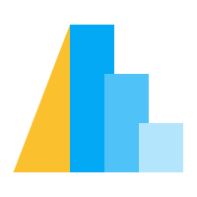



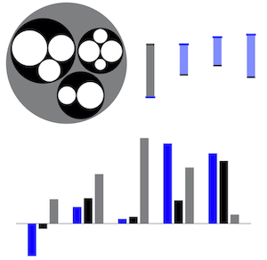
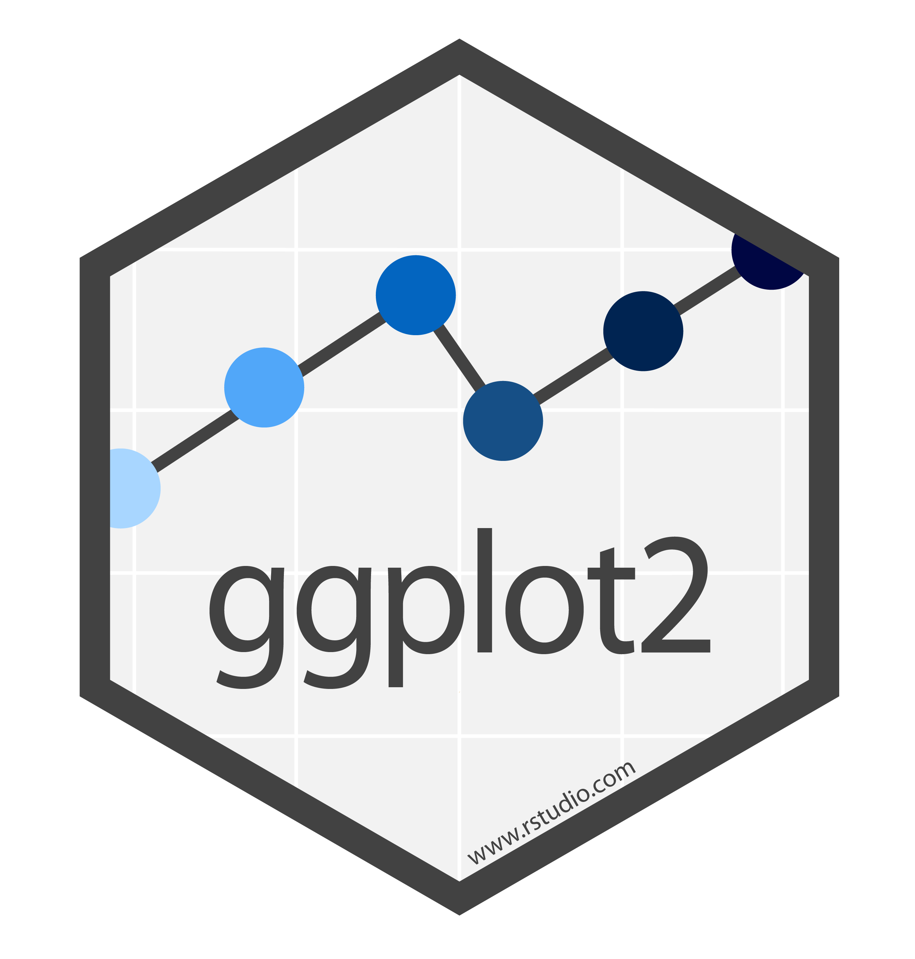

Chartability is well-travelled

Slide 86
Community Involvement has Improved Chartability
Chartability is now on Version 2, with 50 total heuristics (14 of which are critical).

Slide 87
Our challenge:
Can future research consider more than just visual disabilities?

Slide 88
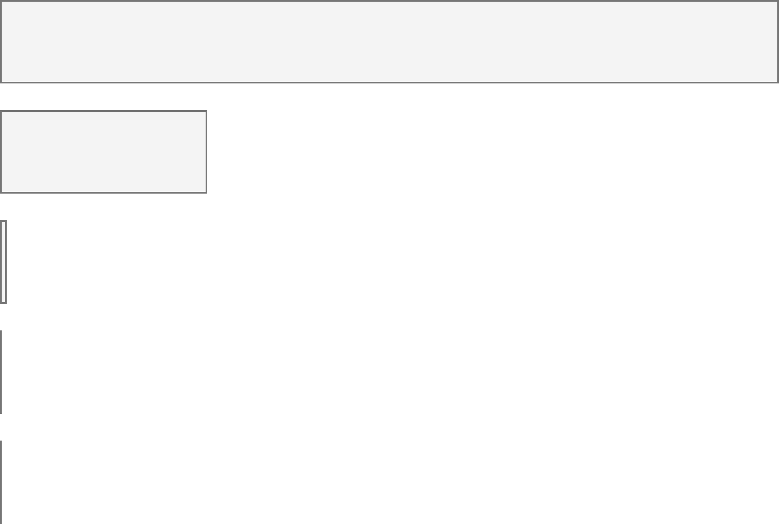
Disabilities in the US
Accessibility in Visualization Research
Color Vision Deficiency
3.7%
Color Vision Deficiency
233
Blindness, Low Vision
4.5%
Blindness, Low Vision
62
Cognitive, Neurological
10.8%
Cognitive, Neurological
2
Motor, Dexterity
13.7%
Motor, Dexterity
0
Vestibular, Motion
7.4%
Vestibular, Motion
0

Slide 89
Every area of disability affects data visualization work.
Visual design
3.7%
Color Vision Deficiency
Non-visual design
4.5%
Blindness, Low Vision
Narrative design, statistics, storytelling
10.8%
Cognitive, Neurological
13.7%
Motor, Dexterity
Interaction design, device considerations, performance
7.4%
Vestibular, Motion
Animation, transitions

Slide 90
My future work:
How do technical design materials influence practitioner behavior?

Slide 91
Why do practitioners use the wrong tools? Can better tools shape how they imagine the potential of their work?

Slide 92
CHARTABILITY
Frank Elavsky, Comm Talk, 2022 @FrankElavsky
frank.computer/chartability
How accessible is my visualization? Evaluating visualization accessibility with Chartability.
hcii.cmu.edu
axle-lab.com
dig.cmu.edu
by Frank Elavsky, Cynthia Bennett, Dominik Moritz

